Slide 1

Learning Expressive Latent Priors via Interpolant Matching Models (IMM) in Variational Autoencoders
Muhammad Imran Hossain
800430917

Slide 2

OUTLINE
Project Goal
Motivation
Problem formulation
Related work
Proposed Method
Results & Discussion
Future Work
Conclusions
Questions

Slide 3
Project Goal
Goal:
To enhance latent representation learning by replacing the simple Gaussian VAE prior with a learned IMM (latent-diffusion) prior for higher-fidelity and more structured generation.
Problem:
  VAEs (Variational Autoencoders) are fast but produce blurry images due to the Gaussian prior bottleneck.
  Diffusion Models (DDPM) produce sharp images but are computationally expensive (operating in pixel space).
Solution: Latent Diffusion.
  Train a VAE to compress images into a small latent space.
  Train a Diffusion Model to generate these latent codes.

Slide 4
Motivation
VAEs produce blurry or unrealistic samples due to the over-simplified N(0,I) prior.
Latent-space diffusion / IMM enables expressive, multimodal latent distributions while remaining computationally efficient.
Bridges theoretical gap between VAEs (probabilistic reconstruction) and diffusion/flow models (powerful priors).
Practical impact:
More realistic and diverse image synthesis.
Better latent semantics for downstream tasks (editing, interpolation).
Foundation for advanced generative architectures (VAE & NVAE variants).

Slide 5
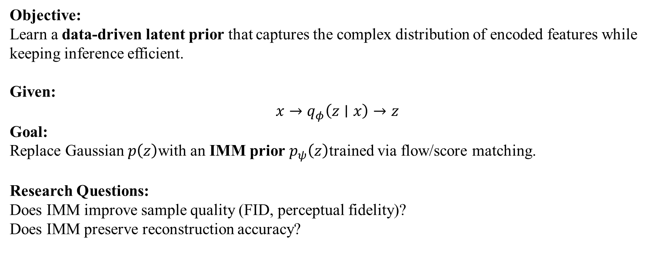
Problem Formulation
Objective:
Learn a data-driven latent prior that captures the complex distribution of encoded features while keeping inference efficient.
Given:
$$x→q_{φ}\left(z∣x\right)→z$$
Goal:
Replace Gaussian $p\left(z\right)$with an IMM prior $p_{ψ}\left(z\right)$trained via flow/score matching.
Research Questions:
Does IMM improve sample quality (FID, perceptual fidelity)?
Does IMM preserve reconstruction accuracy?

Slide 6
Related Work
Approach | Idea | Limitation / Difference vs IMM
VAE | Gaussian prior + ELBO loss | Over-simplified latent space
β-VAE / VampPrior | Disentanglement / mixture prior | Still limited flexibility
MMD-VAE | Kernel matching instead of KL | No dynamic transport learning
Flow / Diffusion Models | Rich priors via invertible maps | High compute, pixel-space cost
IMM (latent diffusion) | Flow-matching on interpolated paths + MMD | Efficient, stable, non-Gaussian prior

Slide 7
Two-Stage Architecture
Methodology: A decoupled learning approach.
Stage 1: Representation Learning (The "Compressor")
  Goal: Compress High-Res Image x to Low-Dim Latent z.
  Models Tested:
    Standard VAE: Single latent layer. simpler, but blurry.
    NVAE (Nouveau VAE): Hierarchical (Global + Fine) latents. Sharper reconstruction, tougher to train.
  Regularization:
    KL Divergence: Standard probabilistic approach.
    MMD (Maximum Mean Discrepancy): Kernel-based matching (tested as alternative).
Stage 2: Prior Learning (The "Generator")
  Goal: Learn the distribution p(z) to generate new samples.
  Models Tested:
    DDPM (Denoising Diffusion): Learn to denoise random noise into valid z. (High quality, slower).
    IMM (Integrated Moment Matching): Learn a direct ODE flow (transport map) from noise to z. (Faster sampling).

Slide 8
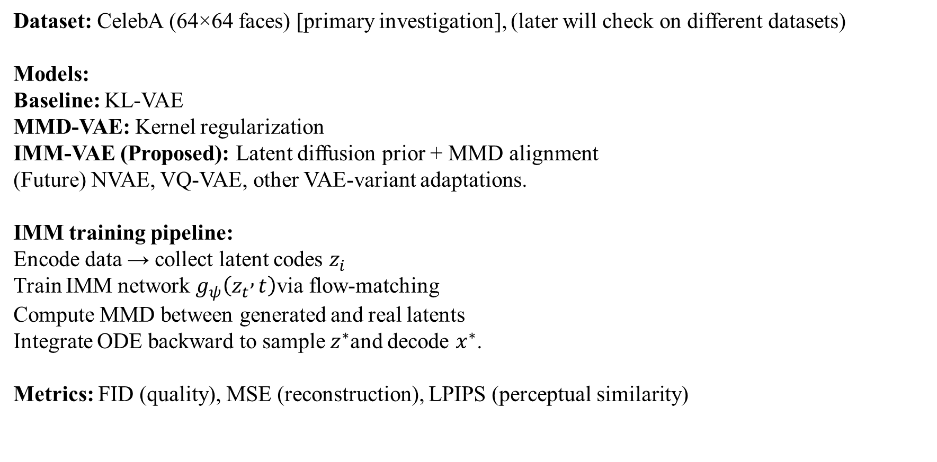
Experimental Setup
Dataset: CelebA (64×64 faces) [primary investigation], (later will check on different datasets)
Models:
Baseline: KL-VAE
MMD-VAE: Kernel regularization
IMM-VAE (Proposed): Latent diffusion prior + MMD alignment
(Future) NVAE, VQ-VAE, other VAE-variant adaptations.
IMM training pipeline:
Encode data → collect latent codes $z_{i}$
Train IMM network $g_{ψ}\left(z_{t} , t\right)$via flow-matching
Compute MMD between generated and real latents
Integrate ODE backward to sample $z^{∗}$and decode $x^{∗}$.
Metrics: FID (quality), MSE (reconstruction), LPIPS (perceptual similarity)

Slide 9
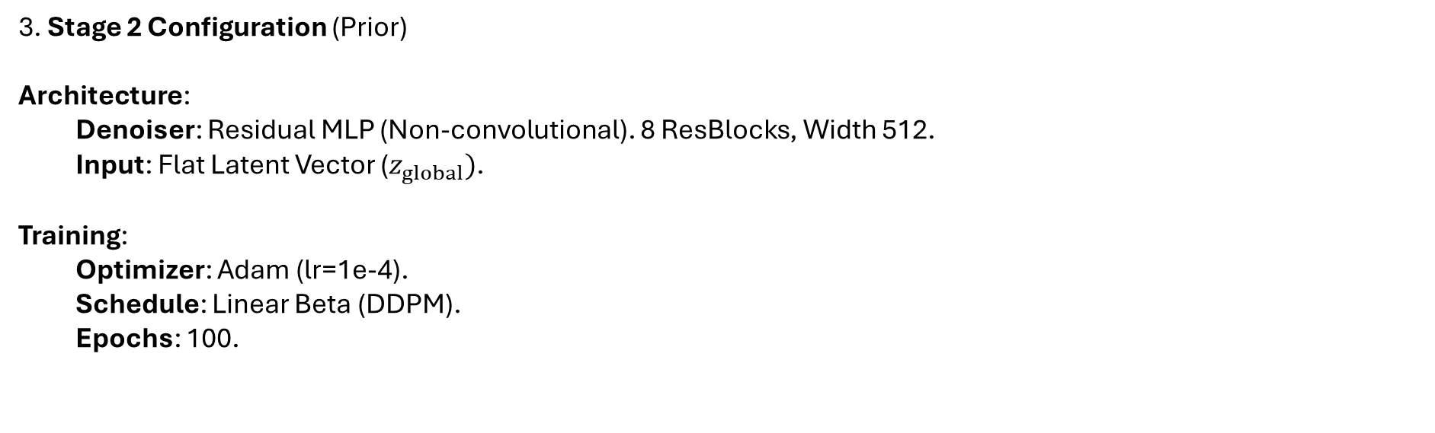
Experimental Setup
3. Stage 2 Configuration (Prior)
Architecture:
  Denoiser: Residual MLP (Non-convolutional). 8 ResBlocks, Width 512.
  Input: Flat Latent Vector ($z_{global})$.
Training:
  Optimizer: Adam (lr=1e-4).
  Schedule: Linear Beta (DDPM).
  Epochs: 100.

Slide 10
Evaluation Framweork
Visual Reconstruction
Goal: Assess how much detail is lost during compression ($x \to z \to \hat{x}$).
Method: Side-by-side comparison of Original vs. Reconstructed images.
Key Metric: Visual Sharpness (Edge preservation).
2. Generative Comparison
Goal: Visual quality check of the Prior.
Method: 8x8 Grid showing:
  Row 1: Real Images.
  Row 2: VAE/NVAE Baseline Generation.
  Row 3: Latent Diffusion (DDPM/IMM) Generation.
Key Insight: Demonstrates the "Prior Mismatch" vs "Corrected Prior".

Slide 11
Evaluation Framweork
3. Quantitative Analysis
Goal: Rigorous numerical benchmarking.
Method:
  FID (Fréchet Inception Distance): Calculated on 5000 samples vs Test Set. Measures realism/diversity.
  MSE/LPIPS: Measures reconstruction fidelity.
  t-SNE Visualization: Projects 64-dim latents to 2D to visualize the overlap between Real Data (Blue), Gaussian Noise (Gray), and Learned Prior (Red).

Slide 12
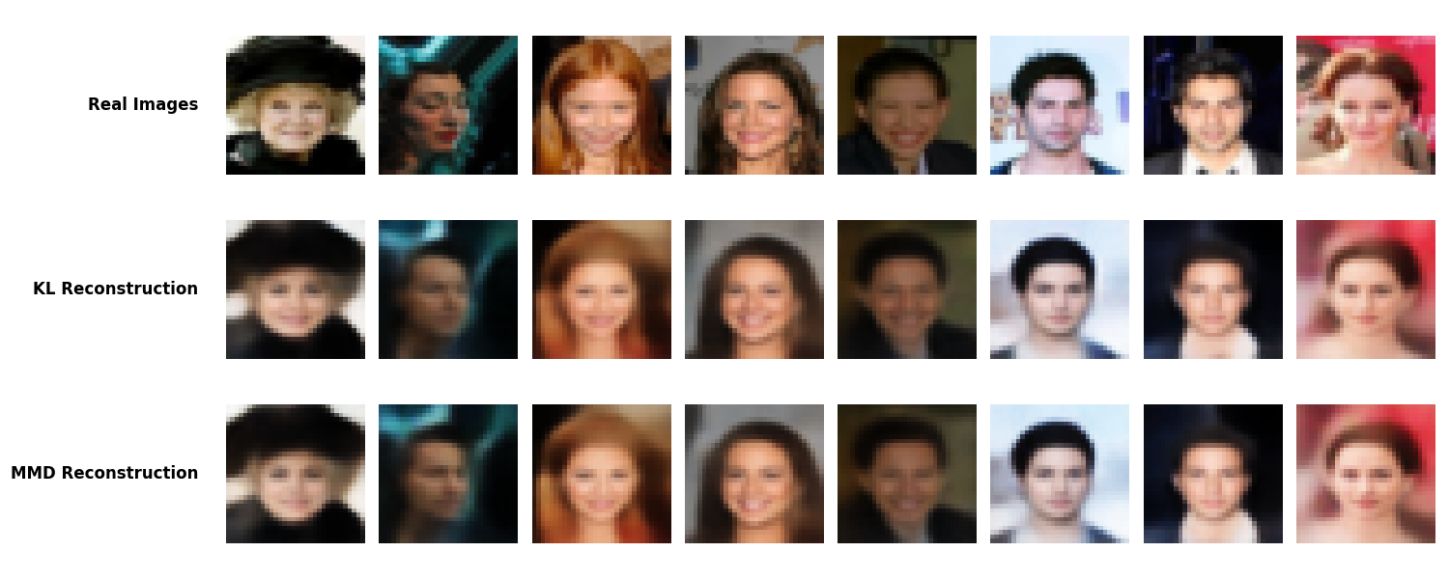
Results(Reconstruction)

Slide 13
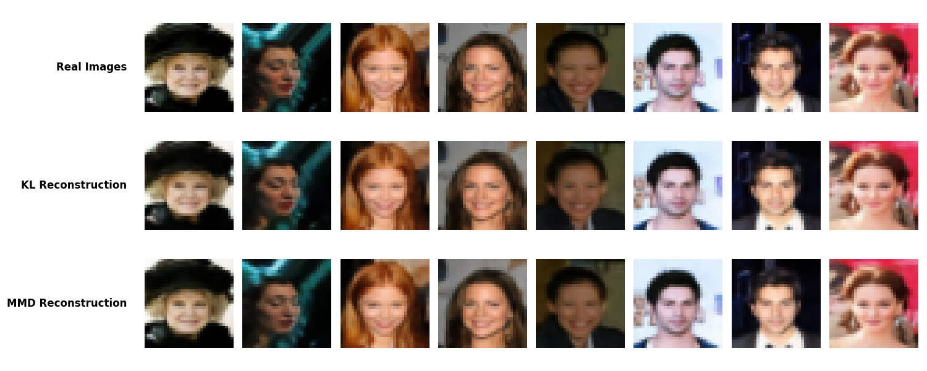
Results(Reconstruction)

Slide 14
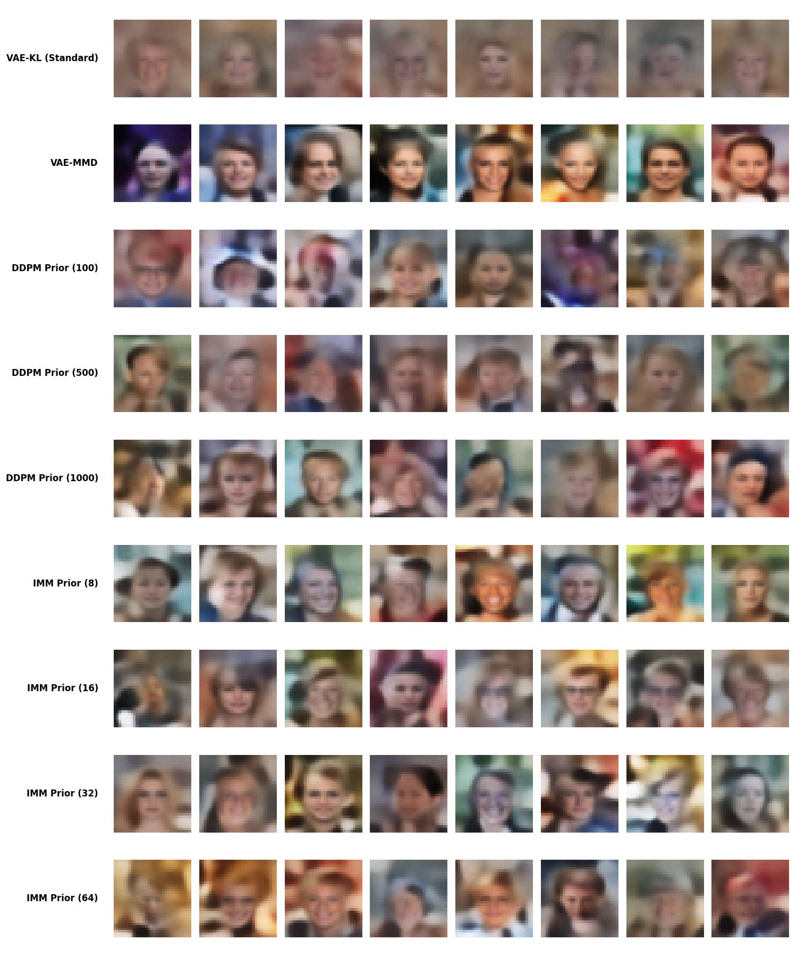
Results(Generation)

Slide 15
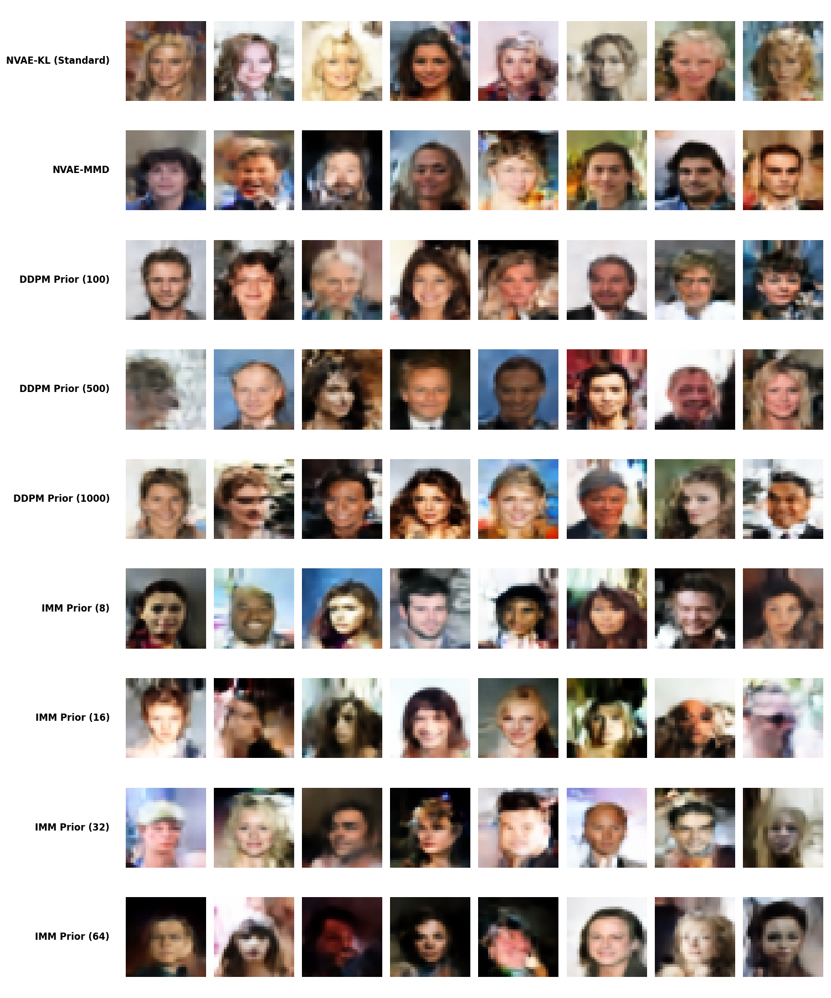
Results(Generation)

Slide 16
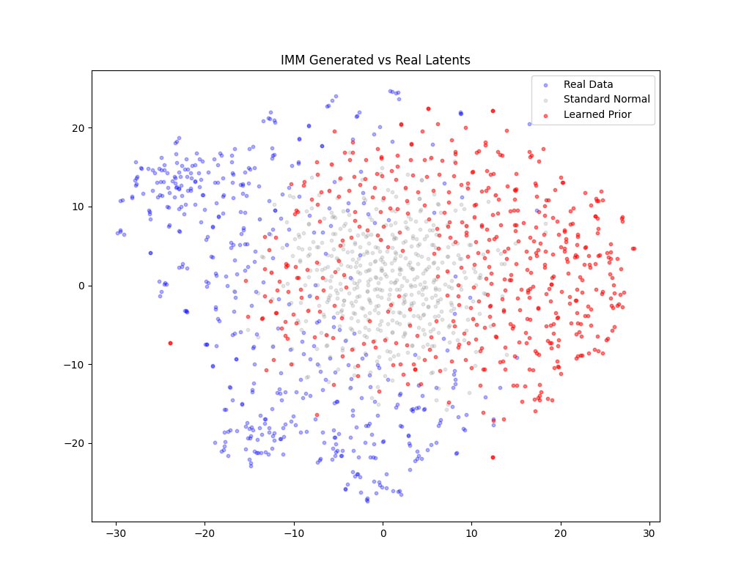
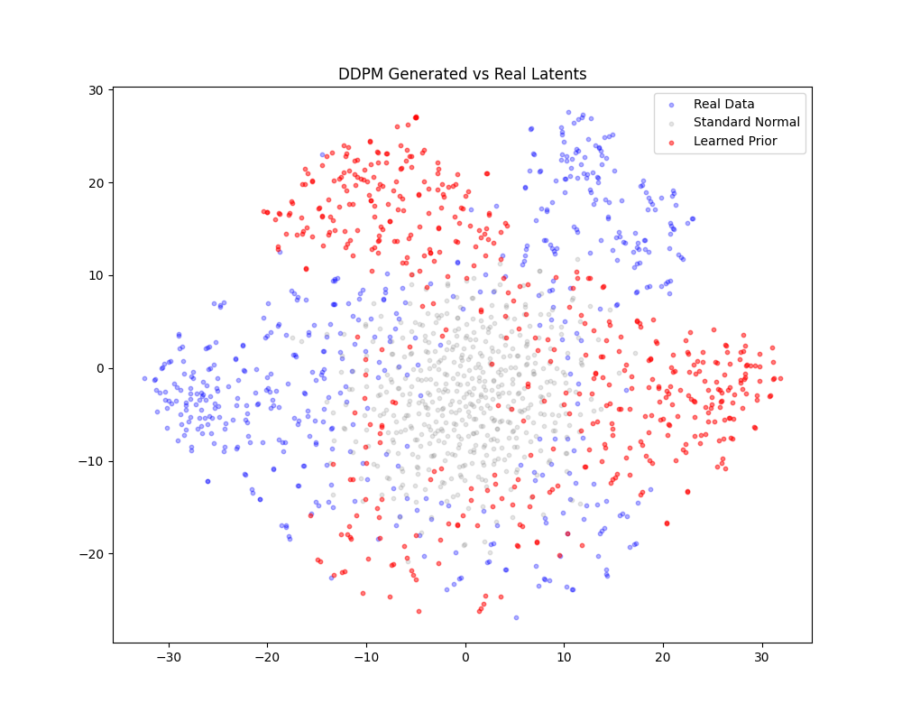
Results(t-sne for VAE)

Slide 17
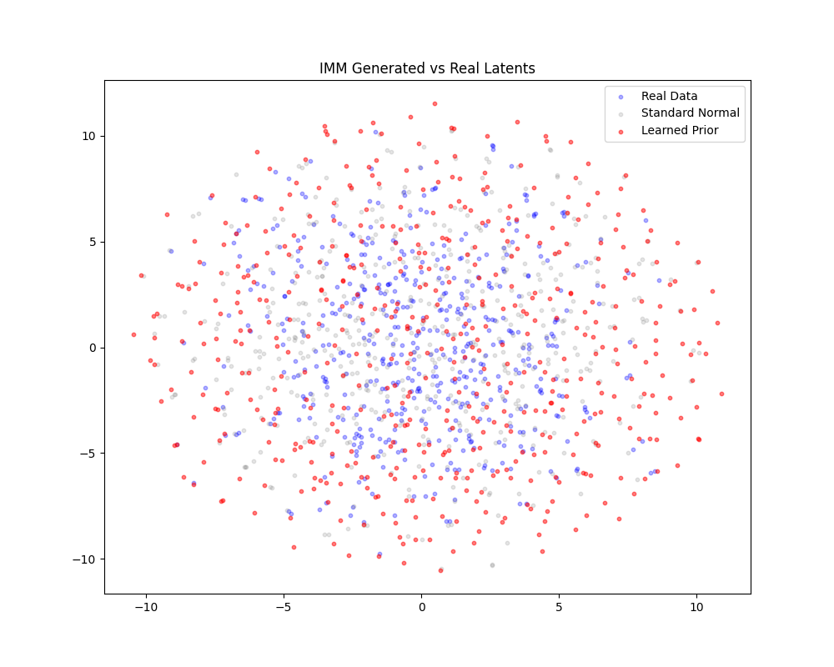
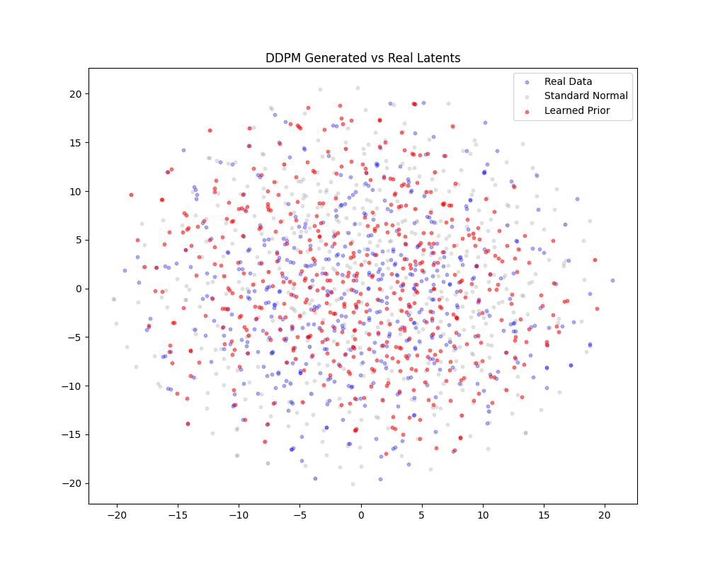
Results(t-sne for NVAE)

Slide 18
Result Comparison (VAE)
Method | Steps | MSE | RMSE | LPIPS | FID
KL-Base | - | 56.06131 | 7.48741 | 0.041062 | 147.5376
MMD-Base | - | 56.06073 | 7.487372 | 0.040855 | 49.89724
DDPM | 100 | - | - | - | 100.8338
DDPM | 500 | - | - | - | 100.5229
DDPM | 1000 | - | - | - | 100.6822
IMM | 8 | - | - | - | 95.75831
IMM | 16 | - | - | - | 95.45141
IMM | 32 | - | - | - | 95.6861
IMM | 64 | - | - | - | 95.30558

Slide 19
Result Comparison (NVAE)
Method | Steps | MSE | RMSE | LPIPS | FID
KL-Base | - | 5.371127 | 2.317569 | 0.001806 | 44.11937
MMD-Base | - | 5.291257 | 2.300273 | 0.001784 | 42.26142
DDPM | 100 | - | - | - | 37.7387
DDPM | 500 | - | - | - | 36.76902
DDPM | 1000 | - | - | - | 36.63936
IMM | 8 | - | - | - | 34.08461
IMM | 16 | - | - | - | 33.36809
IMM | 32 | - | - | - | 33.45464
IMM | 64 | - | - | - | 33.35478

Slide 20
Future Work
Deeper Hierarchy: Move from 2-level NVAE to 3+ levels for 256x256 image generation.
End-to-End Tuning: Fine-tune Stage 1 (Decoder) during Stage 2 training (Loss gradients flow back).
Classifier-Free Guidance: Add class conditioning (e.g., "Smile") to the DDPM prior for controllable generation.

Slide 21
Conclusions
IMM offers a computationally light but expressive latent prior.
Enhances VAEs without pixel-space diffusion cost.
Promising step toward hybrid latent diffusion architectures in next-gen generative models.

Slide 22

Thank You

Slide 23

Any Question?

